Slide 1
Classify Liver Fibrosis Stage Using Gadoxetic Acid-Enhanced MR Images
Master Thesis Presentation
Yi Cheng Lu
2019/06/05

Slide 2
Outline
Background
Motivation
Dataset
Reproduce RFI
Method
Results
Problem and Improvement
Traditional M.L
Deep Learning
Conclusion
Notes:
First, Introduce the background very briefly and the motivation that triggered this thesis(the original goal of this thesis)
Then, introduce the data set used in this thesis.
Later, following is the main part of this presentation.
First, shows the preliminary result on reproduced RFI(this will introduce in later section).
And then the problem we encountered and how we solve it, and the improved result on traditional ML and Deep Learning.
Finally, I’ll give a short conclusion of the whole procedure

Slide 3
Background
Notes:
No introduce the background of this thesis. Include MRI and Liver fibrosis

Slide 4
MRI
Magnetic Resonance Imaging
Magnetic flux density measured in Tesla(T), most clinical MRI performed at 1.5T or 3T
Take advantage of nucleus intrinsic property called spin
Focus on Hydrogen, since water makes up 70% of our body
Produced using a series of pulse sequence which contains RF pulses and gradient pulses
With different setting we can get different contrast image
Gadoxetic Acid-enhanced
Contrast enhancement agent
Can improve lesion detection
Notes:
This slice introduce the basic of MRI very very briefly.
Earth magnetic field is 0.00003T, 100 thousand times stronger than earth magnetic field
RF = Radio frequency
Originally, the direction of spin is random.
First, using a strong static magnetic field to let the nucleus distribute regularly (parallel or antiparallel to the magnetic field).
Then, using RF to disturb the nucleus, trigger a phenomenon called precession(the RF frequency is same as procession frequency, which is fixed and related to static magnetic field).
After the disturbance, the signal of the magnetic moment difference is observed.
Different tissue we can observed different signal pattern.
To get the spatial information, the magnetic field gradient is used which let nucleus at different position experience different
magnetic field and has different magnetic moment variation.
To obtain a 3D body image, there are three gradient coils, each corresponding to one of the three directions - X, Y, Z axis.
Repetition Time (TR) is the amount of time between successive pulse sequences applied to the same slice.
Time to Echo (TE) is the time between the delivery of the RF pulse and the receipt of the echo signal.
T1-weighted/ T2-weighted/Diffusion weighted imaging (DWI)/Fluid Attenuated Inversion Recovery (Flair) etcetera…

Slide 5
Liver fibrosis
Caused after a person’s liver got injury or inflammation and the liver cell want to heal the wound
During the healing, excess proteins accumulate in the liver
After several healing procedures, the excess proteins form the fibrosis in the liver
There are 5 stages. From F0(no fibrosis)~F4(cirrhosis) (METAVIR)
With more and more severe liver fibrosis, finally, the liver will become cirrhosis which then leads to liver cancer
Liver cancer is the 5th highest death number of cancer and also the 6th highest new cases of cancer among the world in 2018
Notes:
From one popular scoring system call METAVIR
The gold standard way to examine liver fibrosis now is through biopsy which is an invasive way.
It takes a small part of liver tissue and examined by an expert.
There are also some non-invasive methods such as blood test or ultrasound

Slide 6
Motivation

Slide 7
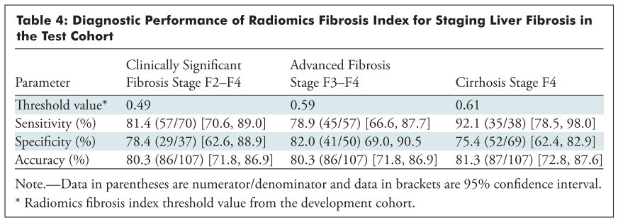
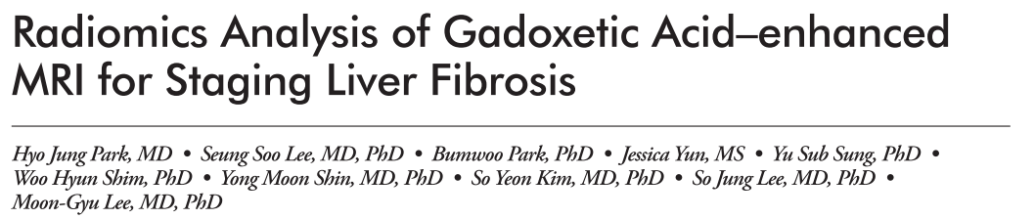
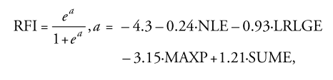
Motivation
Notes:
The motivation is from a paper of a Korean team.
They proposed a simple formula and reach a good result on classifying liver fibrosis using only MR Images

Slide 8
DataSET

Slide 9
Dataset-1
NILB dataset
1.5T MRI Image
Total 91 samples
Contains
Stage 0: 29
Stage 1: 16
Stage 2: 25
Stage 3: 14
Stage 4: 7

Slide 10
Dataset-1
Split into 2 class classification question, EX:
0~1 vs 2~4 : 45 VS 46
0~2 vs 3~4 : 70 VS 21
0~3 vs 4 : 84 VS 7
Focus on problem <0~2 vs 3~4>
Stage3, Stage4 also called Advanced Fibrosis Stage
Notes:
However, it is difficult to classify every stage from others, also our data set isn’t big enough for this purpose.
Reform the question to a 2 class classification problem will be easier, this is also what almost all the paper related to staging liver fibrosis have done

Slide 11
Dataset-2
HIFI dataset
3.0T MRI Image
Total 33 samples
Contains
Stage 0: 10
Stage 1: 7
Stage 2: 7
Stage 3: 8
Stage 4: 1
Notes:
The purpose of this data set will mentioned later.

Slide 12
Reproduce RFI

Slide 13
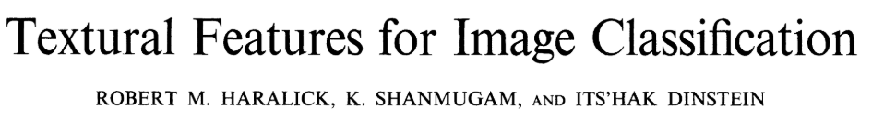
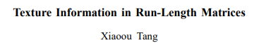
Method
Texture matrix for gray level image
GLCM: Gray-Level Co-Occurrence Matrix
GLRLM: Gray-Level Run Length Matrix
Extract features from these two matrix according to:
Notes:
Since MR images are all gray-scale images, researches are focus on how to extract feature from gay-scale images.
Two popular matrices dedicated to this usage are used in this paper. I will skip what they actually are. Lots of detail can find online or in my final report.
In the presentation, this is just the minor.
These two matrices are just like a summary of the image, more effort is needed to extract the true features from the image.

Slide 14
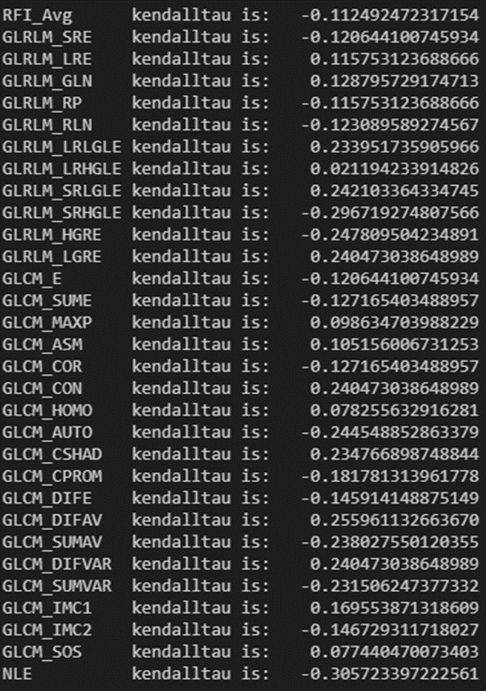

METHOD
Total 30 features
https://github.com/eugeneALU/Master-Thesis/tree/master/Matlab
Notes:
Here are all the features I extracted according to the paper from those two matrices.
Not all are used in RFI, the usage of other features will mentioned later.
The detail of the implementation of feature extraction can be found in my github.
NLE stands for Normalized Liver Enhancement comes from another paper.
It is related to liver relative enhancement. Simply, just the relative image intensity of the liver parts with other parts in MR images.
The value here is measured by staff in the hospital and record in a file.

Slide 15
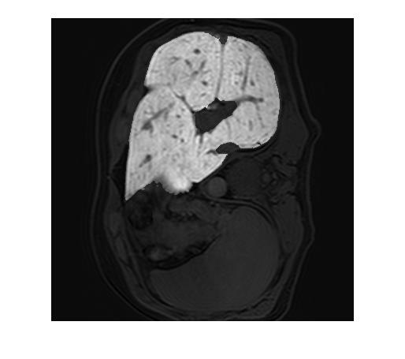
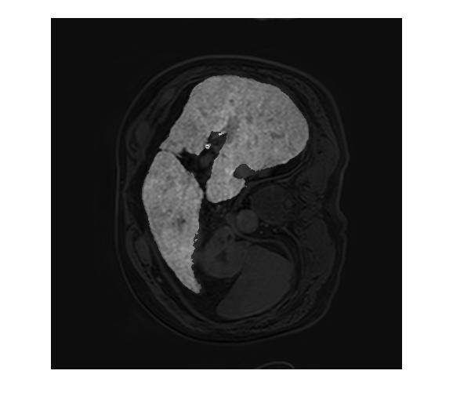
Result - RFI
Stage_0
Stage_4
Notes:
The example raw image

Slide 16
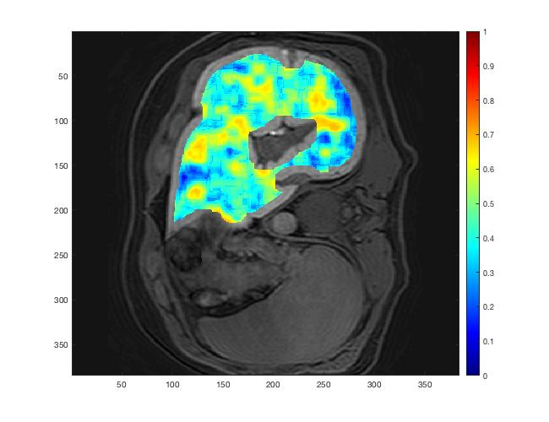
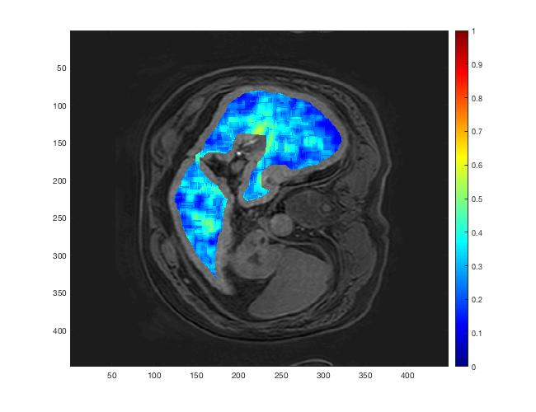
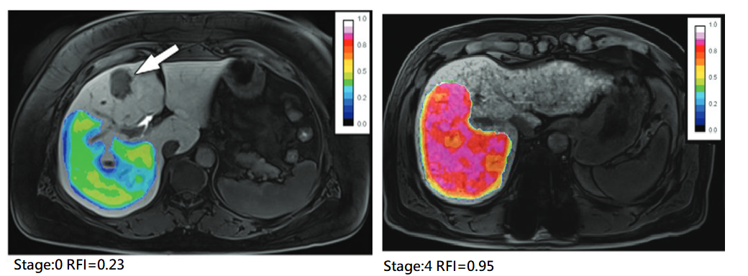
Result - RFI
Stage_0
avgRFI = 0.4446
Stage_4
avgRFI = 0.2856
Notes:
Here shows the RFI of each pixel in liver. The boundary is omitted, since it will include the pixel that is out of interest during calculation.
The avgRFI justs show the RFI average among all the pixels.
From the result of the paper, we can observe that more severe fibrosis stage, higher the RFI. However, this is not what we see in our result.
The paper draw ROI(Region of Interest) manually, but I use whole liver as ROI.
Also, how the paper get summarized RFI is not clear, although the paper has mentioned that they took the average of each feature as representative value for each patient. They still show the RFI mapping for each pixel,
the summarized RFI comes from the average of this mapping or the representative features came from averaging is not clear, but I think there won’t be lots of different,
and our result is still bad anyway.

Slide 17
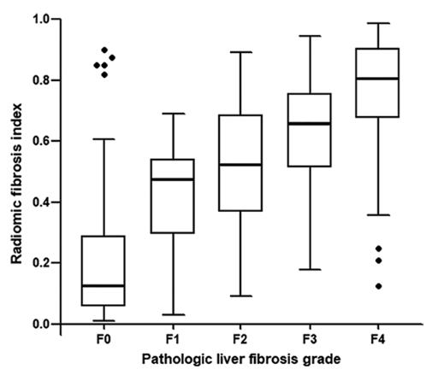
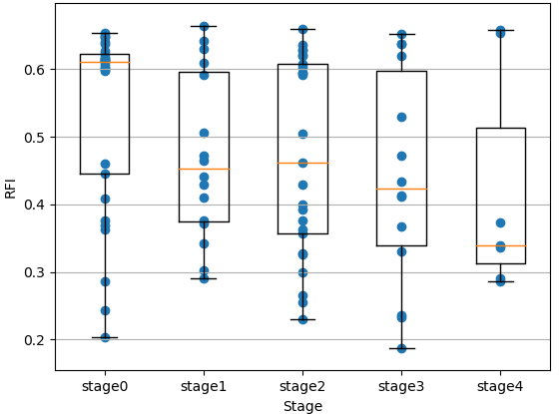
Result - RFI
Notes:
Right : distribution of our RFI, here the RFI means avgRFI. Since without only one value, I don’t know how to summarize all the pixel in an image. I think the paper has done the same thing.
Left: distribution of RFI from the paper.
(NOTICE: the y axis)

Slide 18
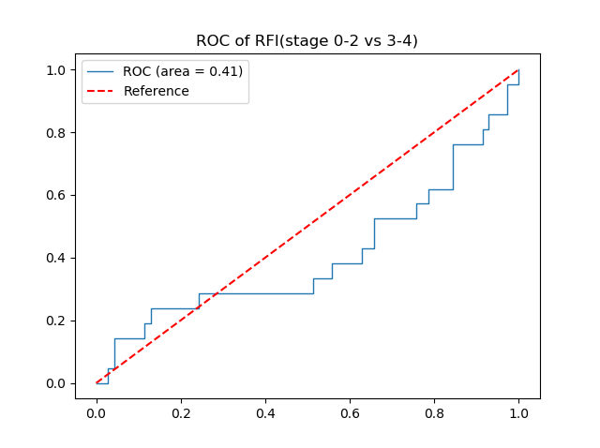
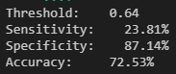
Result - RFI
Notes:
Accuracy seems okay is just because our dataset is skew

Slide 19
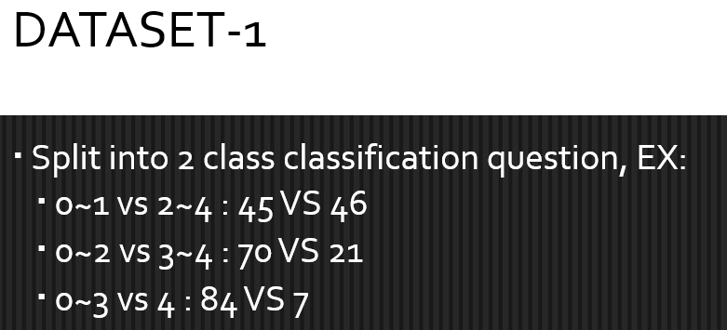
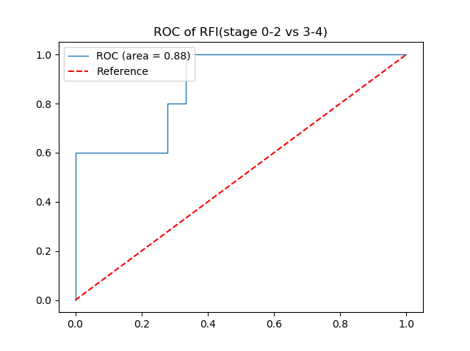
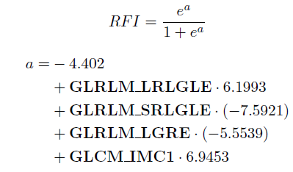
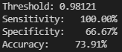
Small Improvement - our own “RFI”
Implement the same procedure of the paper on our own data
Notes:
Seems the original formula work very poor
Here I followed the same procedure proposed in the paper, and train a new formula that fits to our data set.
100% sensitivity 100% is not reasonable….
Since the data set needed to be divided into train and test set, there only 5 positive sample remaining in the test set!!!!
Also, the threshold is too close to 1(RFI is in 0 to 1 interval). <threshold = stage 0~2 >=threshold=stage3~4;
The classifier is very bias, and only reason the classifier act like this is due to the skew dataset.

Slide 20
PROBLEM

Slide 21
Problem
Performance of the original equation is pretty bad
Seems much better when using the same procedure but retrain on our dataset
But
Dataset is too small (Original paper have 384 patients for training)
Dataset is very skew, not enough positive samples
It’s also a big defect if want to try other models
Notes:
We only have 91 patients

Slide 22
Improvement
Solution:
Take each slice from every patient as individual sample points.
Only include slices that contain big enough Liver area(2500 pixel)
Then we get:
Stage 0: 2105
Stage 1: 1105
Stage 2: 1806
Stage 3: 954
Stage 4: 570
Notes:
Here we made a big assumption every patient’s Liver Fibrosis Stage is equally distributed across the whole Liver.
If a patient is labeled as stage 4, every slices from that patient are also labeled as stage 4.
An area threshold is just in case a slice with only small liver area will introduce some noise especially later training a Deep learning models which take only raw image as input.
It’s might not cause too much difference in manual feature extraction methods, since we only extract the feature inside liver region
(Also, if the liver area is too small, it’s not capable to extract the features as mentioned above.
And the algorithm will just omits those slices.)
I’ll mentioned why this is a big and not always true assumption…

Slide 23
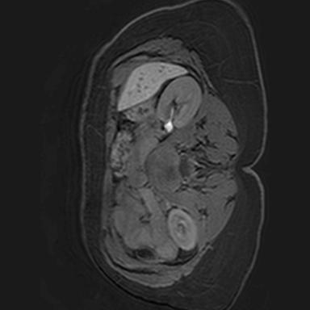
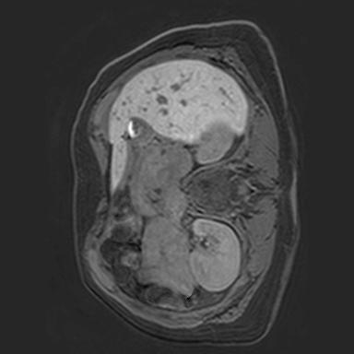
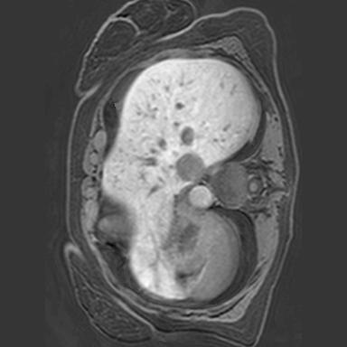
Improvement
Area: 2536
Area: 10165
Area: 22337
AVG:11862
Notes:
Show case…..
AVG is the average liver area among whole slices which is quite larger than the threshold.
So the threshold actually is very small and the purpose is just want to decrease the noise, but wouldn’t filter out too many slices at the same time.

Slide 24
IMPROVEMENT
Split into train/test set
Two set are mutually exclusive in terms of patient
Used these data set to trying different classification models
Train:
Stage 0: 1612 (22)
Stage 1: 795 (12)
Stage 2: 1522 (21)
Stage 3: 811 (12)
Stage 4: 491 (6)
Test:
Stage 0: 493 (7)
Stage 1: 310 (4)
Stage 2: 284 (4)
Stage 3: 143 (2)
Stage 4: 79 (1)
Notes:
Since later we will need to train new models, data set need to be divided into train and test set.
Different Slices data from same patient will only include in train or test set

Slide 25
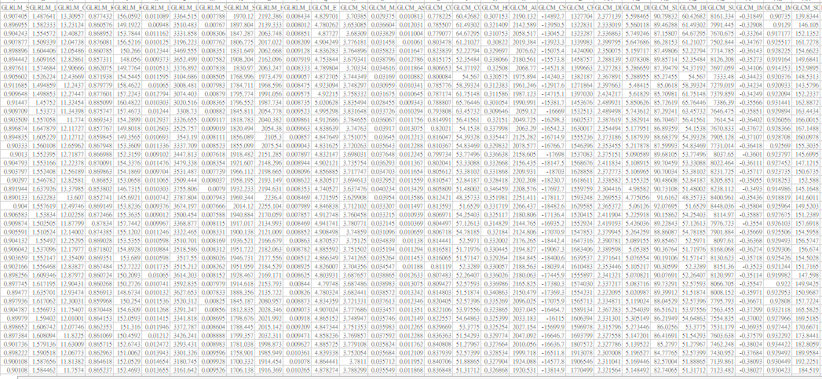
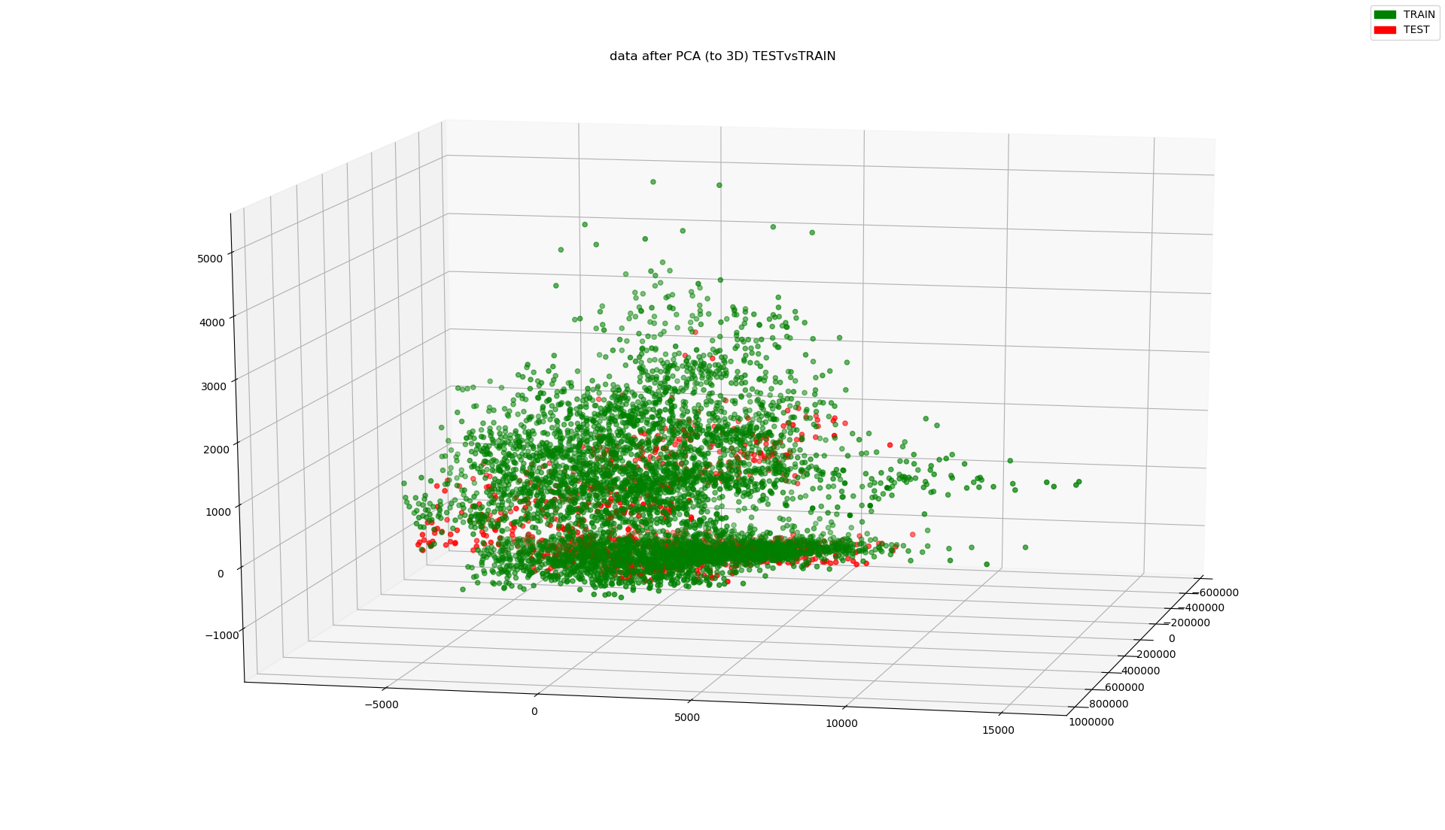
IMPROVEMENT
Notes:
Just show case about the features… and PCA, visualize the distribution
We extract all 29 features (exclude NLE) from every slice.
(Since I can’t get NLE by myself, in the later experiment, NLE will be discarded.)

Slide 26
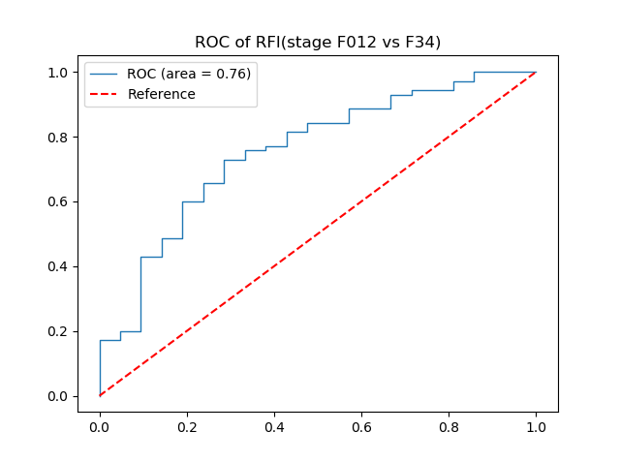
Baseline
Use only NLE as feature(proposed by another paper)
Notes:
Interrupt……
Baseline used for later experiment since previous training based model perform quite poor.
This method only take NLE as an index and classify based on this index.
The detailed will not mentioned here…..

Slide 27
conventional M.L

Slide 28
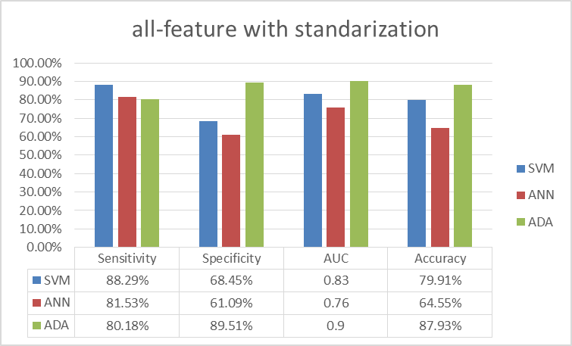
M.L-result
Notes:
Result using all 29 features.
Here I just directly show the results.
Several tests have been done, but not many special technique is used, I don’t go through the training detail.
Just plug in the features into the model, do some fine-tune, and model selection
Several models with default parameters are first testing with 5-fold cross-validation (just think as a validation methods)
Then pick the models that seem promising and fine-tune on those models.
The picture shows the final result of the picked model after fine-tuning
The best one is called Adaboost, AUC=0.9 – a pretty high number

Slide 29
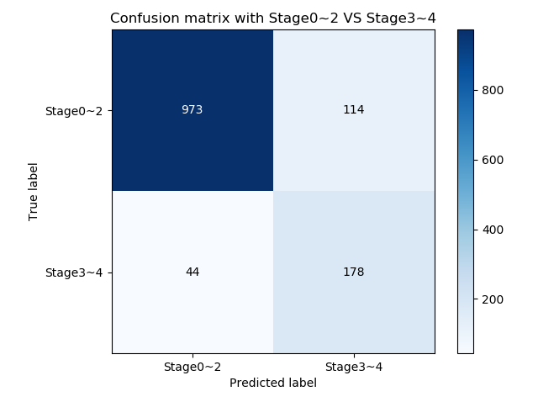
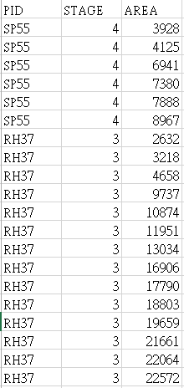
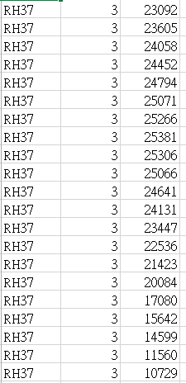
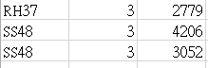
Adaboost
Notes:
Here discuss the problem of our assumption.
We focus on sensitivity here. Since it’s the severe problem in medical application.
Since patient RH37 seems to be only one that have misclassification on almost whole slice. Also, it is in stage 3 which is close to stage 2.
The error might happens in biopsy sampling error. Since the biopsy only take a tiny sample of liver.
Evenly distributed of liver fibrosis is not always true.
This is a big problem in biopsy which mentioned in some paper also.
The main advantage of image method for staging liver fibrosis can solve this problem, since these methods can look through almost the whole liver(although I set a area threshold in this thesis, but it is still larger than what biopsy can test.).
However, the data set we can get now doesn’t take sampling error into account.
The problem is unsolvable in this thesis, in later experiment I will still stick on this assumption.
After all, I don’t even know whether RH37 really has sampling error or not.
I also don’t know how often the sampling error will happen, but I think it won’t happen frequently, or biopsy won’t become a ‘gold standard’
Here I just want to address there is this kind of problem in biopsy and could be addressed using image methods.
Although it is a little contradictory that we want to solve a problem based on a data set that might have that problem.
It might be great if we can acquire a high quality data set which have label for each slice though I don’t know is it feasible.
Or just view these problem as noise, it might be eliminate once we accumulate more and more data.
I hope we can get one high quality data set. At least, nowadays what so -called ‘AI’ system now is based on the data.
More amount, higher quality of data lead to higher intelligence in the system.

Slide 30
Adaboost-Generalizability
Dataset-2 (3.0T)
Same augmentation
Contains
Stage 0: 10 -> 778
Stage 1: 7 -> 646
Stage 2: 7 -> 641
Stage 3: 8 -> 680
Stage 4: 1 -> 103
Notes:
Here we want to test, whether our model also works on another dataset.
Here due to the problem, we also use the same way to augment dataset-2
Also take each slice as individual data point and 2500 area threshold.

Slide 31
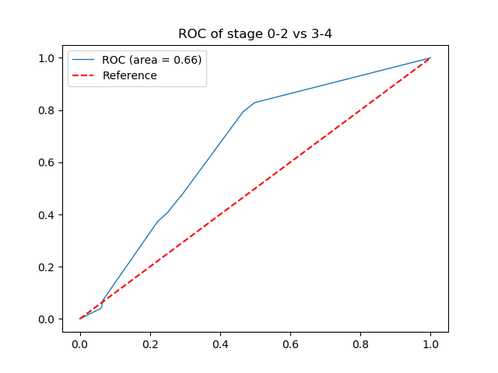
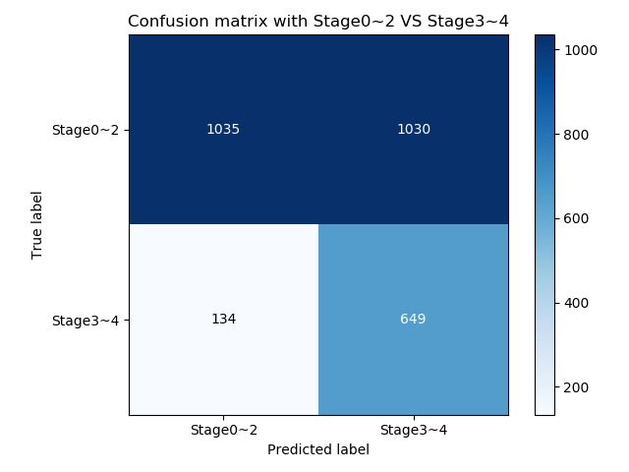
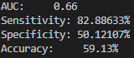
Adaboost-Generalizability
Notes:
Although the sensitivity is good, specificity shows that the model is just guessing .

Slide 32
Deep learning
Notes:
Then we turn to deep learning methods, hope to gain higher performance and higher gerneralizability.

Slide 33
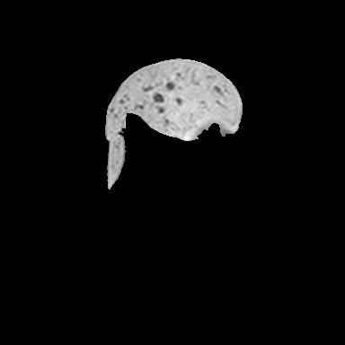
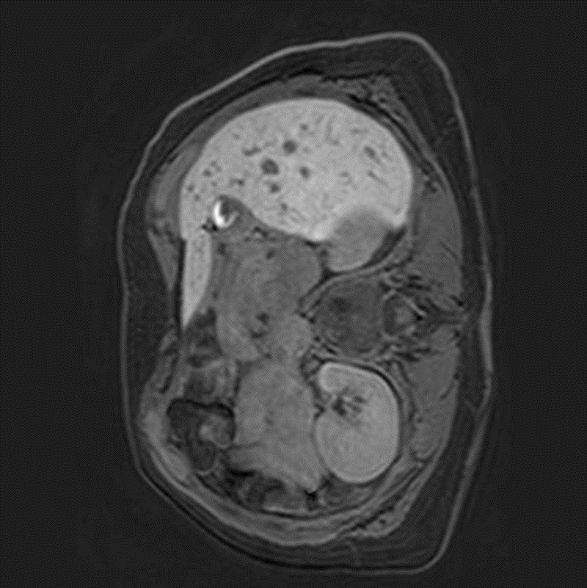
Deep learning
Hot topic
Extract feature automatically
Same slice data set used in previous work
Two kinds of image input
Notes:
With and without liver mask(mask is also labeled by doctors, not me)

Slide 34
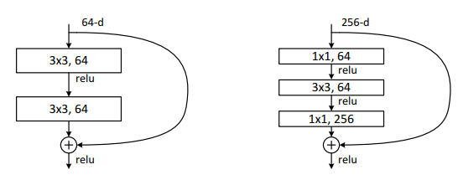
Deep learning – architecture
ResNet
Well known image classification network
With shortcut connection (Residual connect)
Advantage: Much easier to train a very deep model

Slide 35
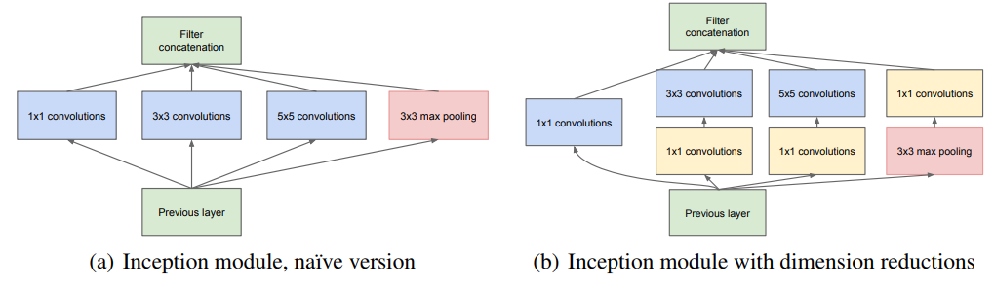
Deep learning – architecture
InceptionV3
Well known image classification network
Parallel connection instead of serial
Notes:
In almost whole the deep learning architecture, the connection between layer is serial.
And the network is growing deeper and deeper. But the inception architecture is connected in parallel, and the network is growing broader and broader

Slide 36
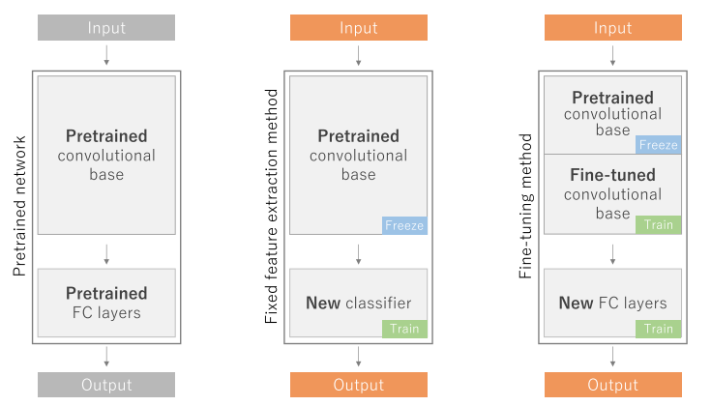
Deep learning
Transfer learning
Fine-tune a pre-trained model that originally aimed for task A in order to adapt to task B
Data set for task A which often is very huge and easy to collect, contrary to data set for task B
Notes:
Now, almost all the pre-trained model we can get is pre-trained on the ImageNet dataset. The task of it is to classify 1000 objects which is common in daily life, such as dog, cat, ball, plane and etc…
We need to change the classifier, since our problem is only binary classification problem, which means we only need one output unit instead of a thousand.
Also, since our task is working on MR images, which is quite different form the daily object.
Fine-tuning the intermediate convolutional layer that used as feature extractor is also necessary.

Slide 37
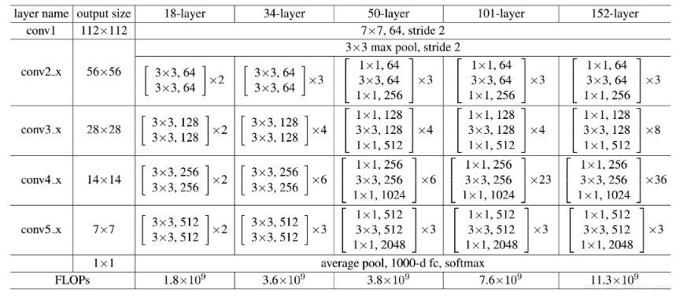
RESneT-18
Main architecture
Fast training and easy to get pre-trained parameters
image input with size 224*224 and 3 channel
Resize the image(from 384*384, 432*432, 448*448)
Duplicate to 3 channel
Samples in a batch is not picking randomly
Since our data set is skew
Picking with the weight
Notes:
Actually, ResNet-18 only contains 18 layer, which cannot show the power of residual connection.
However, fine-tune on the deeper network will cause lots of time, so in this thesis, experiment is first conducted on ResNet-18.
Then transfer to deeper network.
When training a DL model, we often introduce a concept called “batch”.
A batch is just a subset of the whole input set which often contain 16,32 or 64 images.
Weight adjustment is conducted every time with the input of one batch.
Since our data set is pretty skew, samples in each batch are not totally randomly picking but with some weight. The weight of each sample is
inversely proportional to the label amount, so the samples belong to the fewer label will more probable to be picked in order to keep label balance
in each batch.

Slide 38
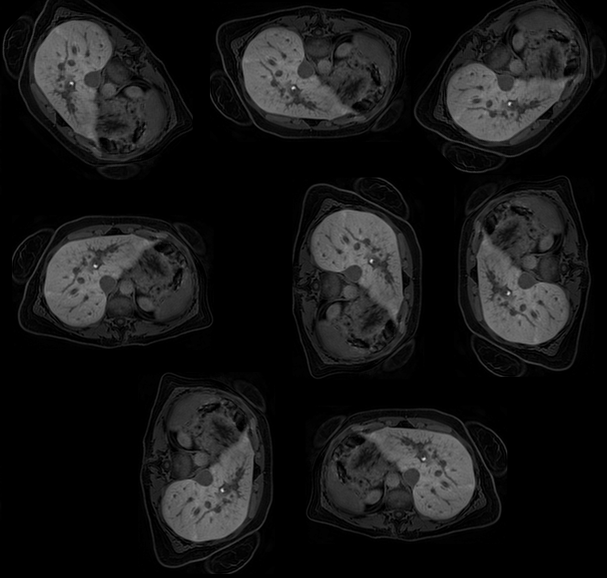
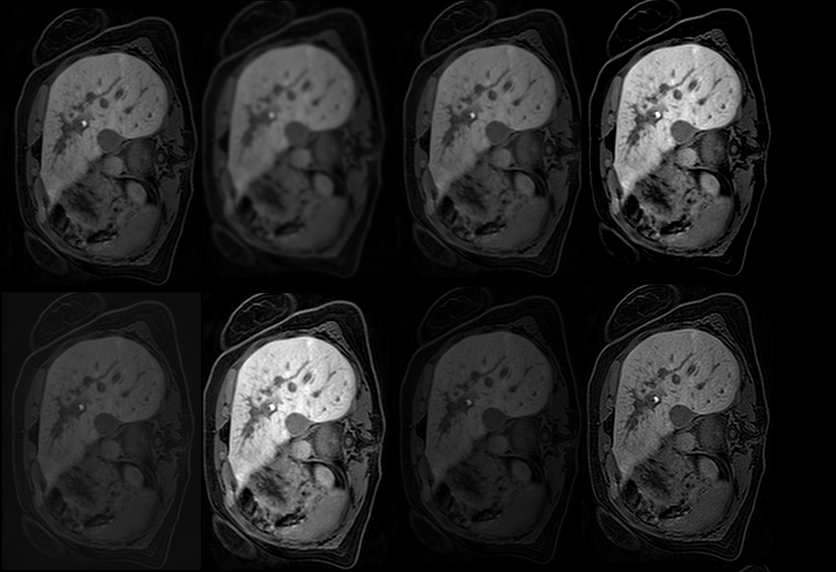
Image Augmentation
Origin
GaussianBlur(radius=2)
MedianFilter(size=3)
Contrast enhance(2)
Contrast enhance(0.5)
Brightness enhance(2)
Brightness enhance(0.5)
Sharpness enhance(5)
Rotate_45
Rotate_90
Rotate_135
TRANSPOSE
FLIP_LEFT_RIGHT
FLIP_TOP_BOTTOM
Rotate_180
Rotate_270
Notes:
In most deep learning training, we will augment our data in several ways which can increase the data we have.
On the other hand, model can see more data with different appearance and increase the performance.
To augment the image data is relatively easy.

Slide 39
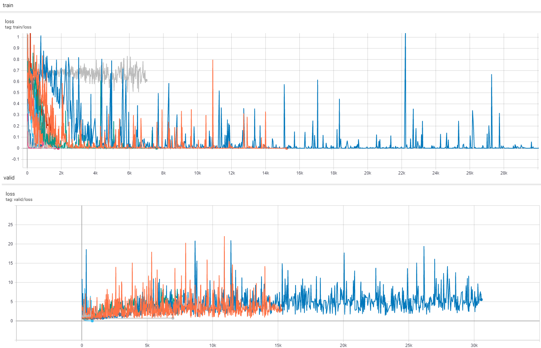
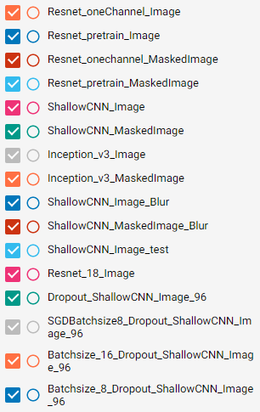
Not Working
Notes:
However, the model is not working.
NOTICE: the y-axis scale in the picture

Slide 40
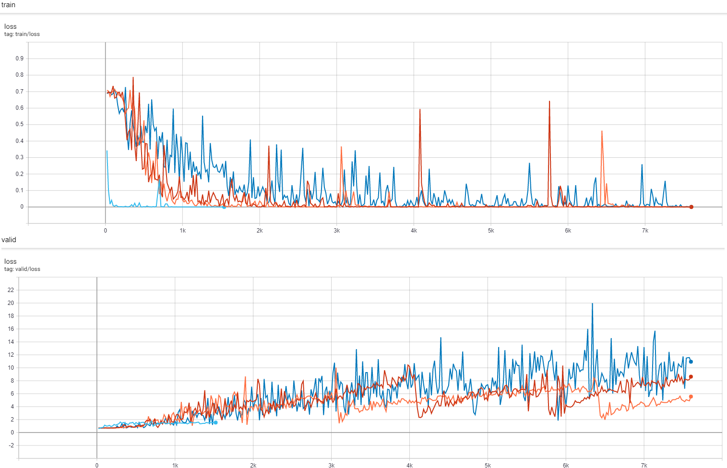
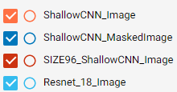
Not Working

Slide 41
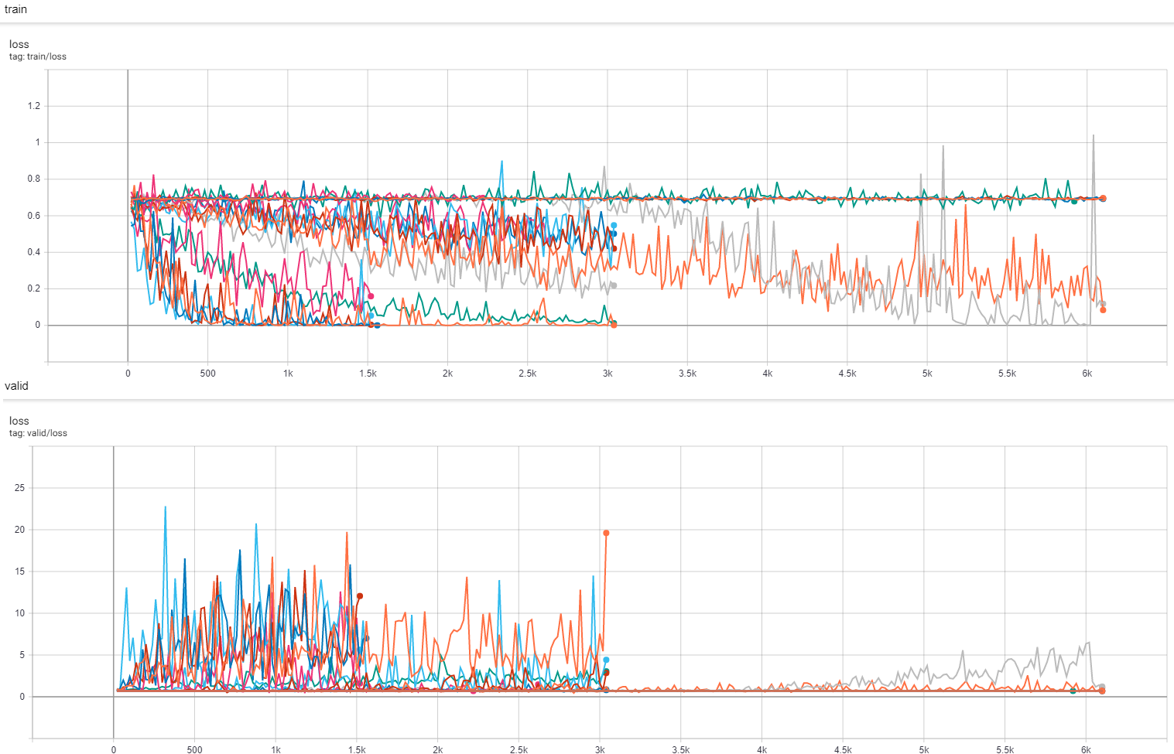
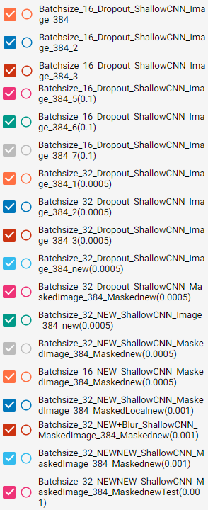
Not Working

Slide 42
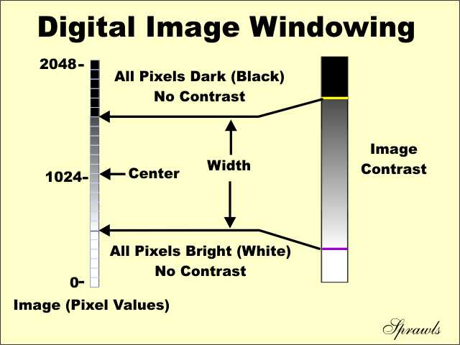
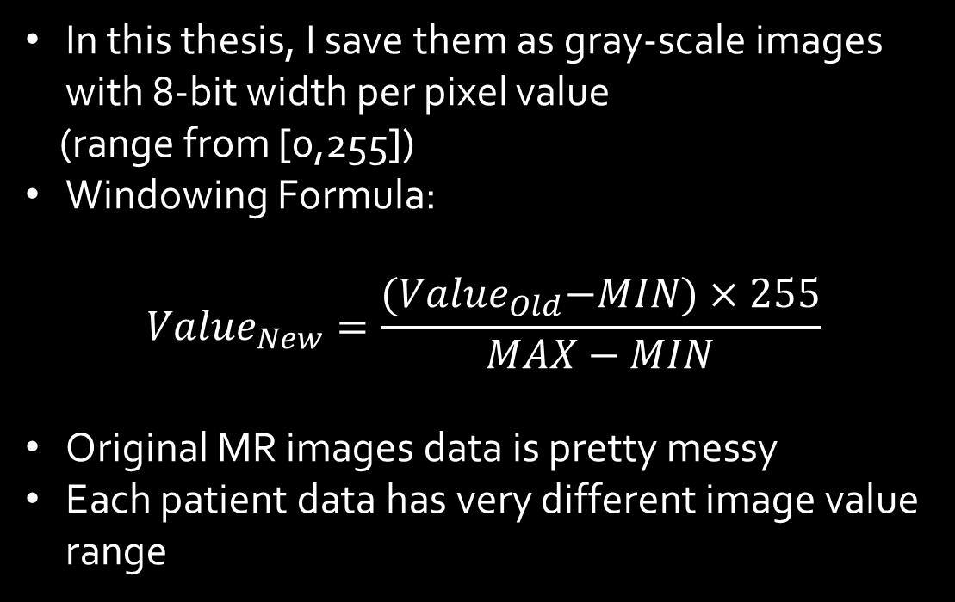
Image windowing
In this thesis, I save them as gray-scale images with 8-bit width per pixel value
(range from [0,255])
Windowing Formula:
$${Value}_{New}=\frac{{(Value}_{Old}−MIN)×255}{MAX−MIN}$$
Original MR images data is pretty messy
Each patient data has very different image value range
http://www.sprawls.org/resources/DIGPROCESS/module.htm
Notes:
After lots of experiment. I found the problem is the windowing method used while I extracted each slice from the raw data and save them into a jpeg file.
Briefly, the windowing method is the way how we convert a set of raw data into an image under our setting.
However, the original MR images data set is pretty messy…..
Some contains value almost same as [0,255] interval while some contains value in [-200,8000].
Also, it is this minus value(I don’t know how they appear) that makes the background (which has 0 value) color not always black.
Previous, I didn’t address this problem and the windowing method used is the Matlab default method.
Which used local minimum and local maximum in each picture.
Obviously, the ‘local’ word means each slice has its own value, then the resulting images are not consistent even if they are adjacent slices.
To deal with those problems, the minimum value of all the slices are manually clamped to 0(which is supposed to be original background value, and I want the background to be always black)
and the maximum value is the global maximum of each patient.
Using the global maximum of each patient can let each slice from each patient to be consistent.

Slide 43
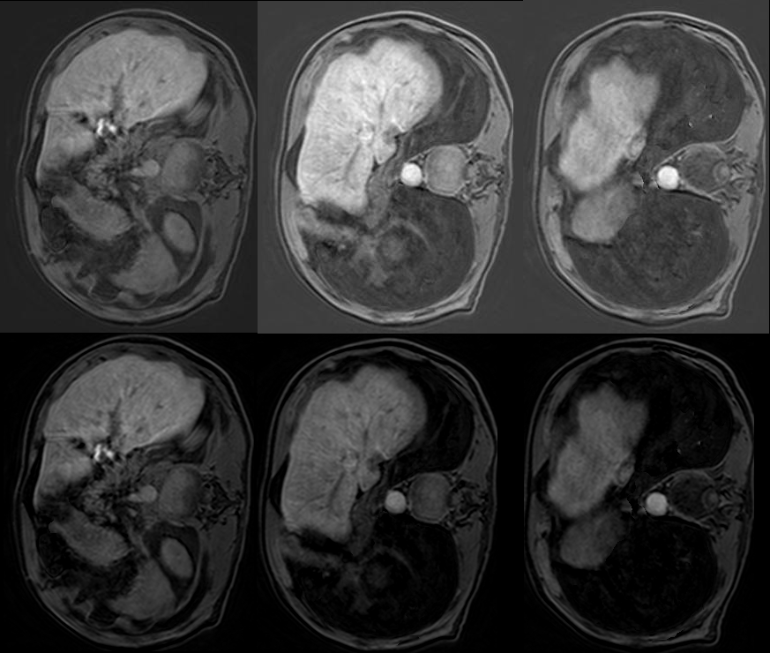

Different Windowing
Local minimum
Vs
Clamp to 0
Local maximum
VS.
Global maximum
Notes:
Although we loss some detail and lowering the contrast, but the image is more consistent.
Later experiment show that the consistent is more important than the detail and image contrast.

Slide 44
Training procedure
Split the training set again(randomly) into training set and validation set
Train: Valid:
Stage 0: 1399 (19) Stage 0: 213 (3)
Stage 1: 446 (7) Stage 1: 349 (5)
Stage 2: 1390 (19) Stage 2: 132 (2)
Stage 3: 688 (10) Stage 3: 123 (2)
Stage 4: 240 (3) Stage 4: 251 (3)
First, train on Train set then test on Validation set. Fine-tuning base on this result
Later, when we find a best setting. Retrain the model on whole training set then evaluate the result on Test set.
Notes:
In DL, there are lots of hyperparameters that need to be fine-tuned. This is also needed in any training based methods.
In previous experiment, I used 5-fold cross-validation. But the training time of DL is much longer than previous traditional ML methods,
5-fold cross-validation is not feasible with limited computation power and time.
So I explicitly divide train set further into training set and validation set.

Slide 45


(Masked) Size different (2500/5000/10000)
Notes:
Model is not perform quite good in small liver area threshold. Here, I adjust the area threshold to 10000 (around average liver area).
The reason is that the performance on area 2500 is poorer than traditional ML models and just almost same as baseline which I think is not worth to further investigate.
And with bigger area threshold, I can reduce the data set and decrease the training time, otherwise training on threshold 2500 really takes too much time.
Also, it is highly possible that the result came from fine-tuning on threshold 10000 is also optimal on threshold 2500.

Slide 46


Windowing different (global/local)
Notes:
Global maximum vs local maximum.

Slide 47


Augment /learning rate different
Notes:
Decreasing learning rate and use augmentation include flip/rotation and transposition.
To test the augmentation that with flip/rotation and transposition is I think every patient enter the MRI machine in the same body position.
So those augmentations might not help.
However, the result shows that the performance is still better with those augmentations though the difference is not obvious.
I think it might because the model can learn some direction irrelevant features.

Slide 48


Masked vs non-Masked
Notes:
With mask or not. The answer is pretty obvious, the main purpose here is to test will the difference be great?

Slide 49



Weight decay
Notes:
The model seems over-fitting very quickly right after the training start, here introduce the weight-decay to address this problem.

Slide 50

Resnet18-Validation
Notes:
Result on area threshold 2500

Slide 51

Resnet18-ValidatioN
Notes:
Result on area threshold 10000, but test on different area threshold.
To test how good or bad of the performance when the model is tested on different liver area images that have never been seen before.
Later, we only report the performance that test on same area threshold.
This slice just tries to show the result if model is tested on different area threshold, and the result seems still acceptable. They do not differ a lot

Slide 52

Resnet18-Validation
Notes:
Show the over-fitting. The optimal stop point is between epoch-15 and epoch-20

Slide 53


Deeper network – ResNET50/101
Notes:
Same best setting on deeper network

Slide 54


Deeper network – InceptionV3
Notes:
Same best setting on deeper network
The pink and light blue line is the optimal setting which we obtained before.
We can observe that the performance is really better compared with other settings.

Slide 55

Result
Notes:
Final result

Slide 56

Generalizability
Notes:
Generalizability is still bad, but as least better than the model that never trained on MRI data set.

Slide 57

Excution time
Notes:
Benefit of DL methods, since extract feature through convolution kernel is pretty fast

Slide 58
Conclusion

Slide 59
Conclusion
Both the traditional model with manual feature extraction and deep learning model performance better than our baseline(AUC=0.76)
DL model is less interpretable. It doesn’t like the traditional model, we know the exact features the model looking at
For both models, a liver mask is necessary.
Compared to traditional methods, deep learning methods don't actually take more time starting from data preparation to test, which may differ from everyone's assumptions.
Both of them works only on 1.5T MRI image, or even only on the image from the same machine which I can’t confirm(since I don’t have another 1.5T MRI image set from a different manufacturer/machine)
Notes:
3. For manual feature extraction method, the liver mask is needed or we need to draw ROI by ourselves, however, DL methods have the potential to get rid of the liver mask. We have also shown the result both with and without mask which actually does not differ a lot.

Slide 60
Future works
Try more models, more fine-tune and maybe more image augmentation
For the traditional method, there’re also lots of different features can be extracted which might improve the model furthermore.
Interpret how the DL model makes the decision(investigate what model is ’looking at’)
Techniques like GRAD-CAM might be helpful
Might try to develop a method that does not need a liver mask
For DL model, should test on smaller area threshold
Collect more data, test and train the model with a more robust way
Frankly, the test set is too small now, the credibility of the performance might be low
Notes:
5. It is hard to get a liver mask data set. It will be easier to train a model without mask data. Or also derived a mask by another model which is a more popular topic-Liver Segmentation.
6. Or develop a model that can determine the exact fibrosis stage. Not just a binary classification but exactly predict the right stage of the patient.
Then, the model can truly be a powerful tool that can discover liver fibrosis in an early stage and do not have sampling error.
This thesis is only an early work on developing a liver fibrosis classifiers based on MR images, and more work is required to be done to develop a truly usable system in the future

Slide 61
Thanks

Slide 62
Appendix

Slide 63


APPENDIX A – GLRLM rotate implement
GLCM(Distance=1, Degree=0,45,90,135, Window size = 15). Using Matlab build in API
GLRLM(Distance=1, Degree=0,45,90,135 , Window size = 15). Self-implement; for degree 45,135, using ZigZag to generate sets of diagonal numbers
Problem with Matlab rotate API:
ZigZag:
Notes:
The reason why we using ZigZag instead of the rotation API build in Matlab

Slide 64

APPENDIX B – Own rfi feature selection
Did not using univariate analysis
(concordance correlation coefficient between two consecutive image sections
https://stats.stackexchange.com/questions/239576/danger-of-univariate-analysis-before-multiple-regression )
Kendall correlation coefficient
Choose the feature with value > 0.2
blue arrow: features used in the paper
Red box : features being selected out
Notes:
Detail about how we select the features that construct our own RFI index formula

Slide 65

Detail C – NLE
As baseline as our further research
From
Notes:
Detail about our baseline

Slide 66


APPENDIX C – NLE

Slide 67


APPENDIX C – NLE

Slide 68
APPENDIX D – Improvement, our own “RFI”
Implement the same procedure of the paper on our own data
Notes:
Only 5 positive sample in the testset

Slide 69



APPENDIX D – Improve RFI with augment data

Slide 70


APPENDIX E – dL model performance

